Slide 1
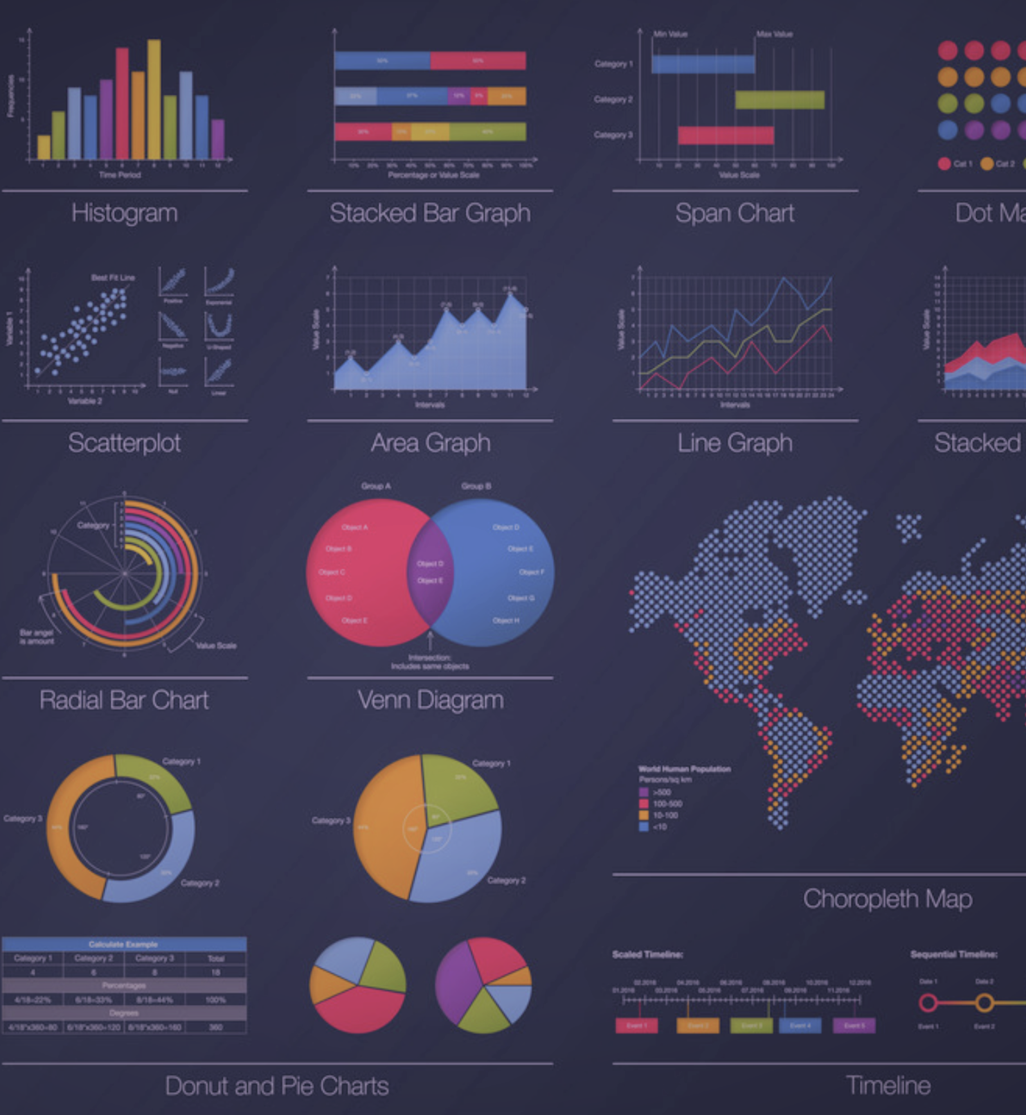

Visual analysis of socio-economics effects on suicides, over the years, in different countries and generations
Manuel ivagnes 1698903
Riccardo bianchini 1700170

Slide 2
Agenda
Introduction
Dataset
Visualizations
Conclusion and Future work
Related work

Slide 3

Introduction
Mental health: “a state of well-being in which the individual realizes his or her own abilities, can cope with the normal stresses of life, can work productively and fruitfully and is able to make a contribution to his or her community”. – Wikipedia
During the lockdown, mental health and suicides got huge attention, and many discussions on this topic started to appear.
Thus, we want to analyze the socio-economics effects on suicides, over the years, in different countries and generations, so that to better understand some of the reasons behind this illness.

Slide 4

Related work
Extensive literature is devoted to studying and analyzing mental health conditions and suicides.
None of them deals with visual analytics environments!
However, some of them gave us ideas on how to build the system.

Slide 5
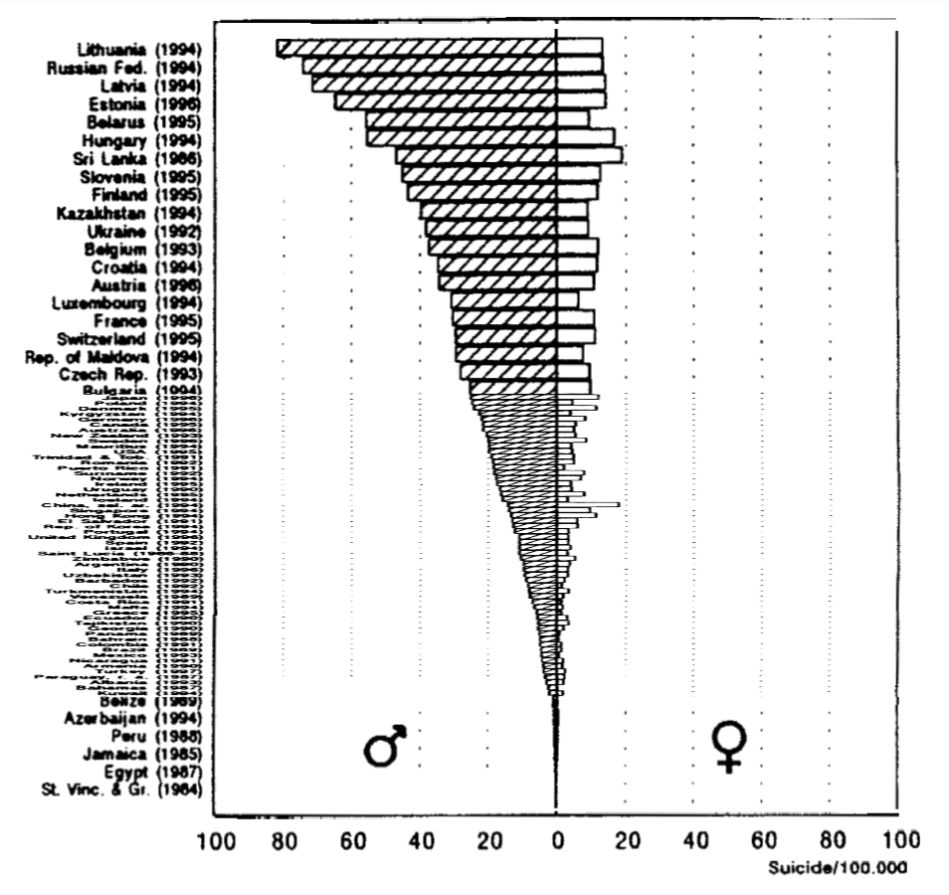
Archives of Suicide Research (1999)
Some insights
It uses the WHO databank to analyze suicides in different countries, taking into particular consideration the role of biological sex.
Suicide rates among the countries differ widely. Hungary was first for long time, but it is being surpassed by some `new` Russian and Baltic states.
Male rates are definitely higher than female rates
What do we take?
Updated version of same dataset
The idea to compare different countries based on suicide ratio (sucides/100k pop)
Extend biological sex separation to peer groups

Slide 6
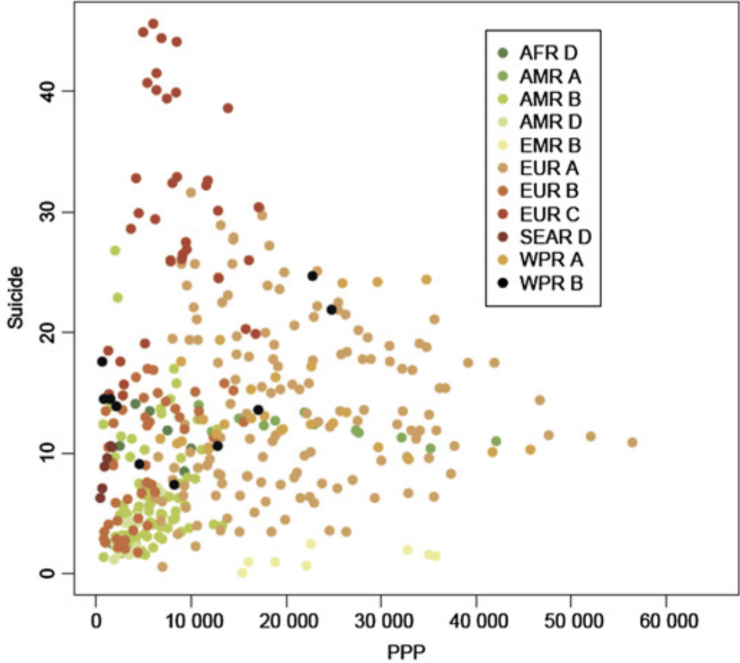
Worldwide impact of economic cycles on suicide trends over 3 decades: differences according to level of development. A mixed effect model study
Some insights
It examined worldwide trends and correlations of PPP-adjusted GDP per capita and suicide rates in 10 WHO subregions during a period of about 30 years
Shows that GDP is strongly correlated to suicide rates worldwide and that the direction and magnitude of the correlation differs between developing and developed countries.
Understand this difference is important to understand how to deal with the problem in the specific country
What do we take?
GDP has significant impact on suicides
Difference between developing and developed countries
Analysis over the year

Slide 7

Dataset
From the WHO databank to our system.

Slide 8

Insights
The Suicide Rates Overview 1985 to 2016 dataset from Kaggle, that was in turn taken from the World Health Organization databank.
Used to find signals correlated to increased suicide rates among different cohorts globally, across the socio-economic spectrum in an interval of time starting from 1985 to 2016.
It contains 27.8k valid entries with the following attributes:
Country
Year
Sex
Age
# Suicide no
# Population
# Suicides/100k pop
Country-year
HDI for year
Gdp for year
Gdp per capite
Generation

Slide 9
Preprocessing and PCA
We checked for the presence of tuples with NULL values in one of the attributes and found that “HDI for year” as mostly null values. Thus, we decided to remove it;
We removed “Country-year” and “Generation” that are redundant for our purpose;
We modified the encoding of the name relative to the age groups so that to remove the suffix “year”. This step is needed to avoid overlap on the visualization;
We searched for differences in the names of countries inside the csv file and the geojson used by the map. Then, we modified the names to have a perfect match. The name that we modified are:
For dimensionality reduction, we applied PCA on: suicide no, population, suicides pop, gdp for year, gdp per capite;
United States -> USA
United Kingdom -> England
Republic of Korea -> South Korea
Russian Federation -> Russia
Serbia -> Republic of Serbia
Bahamas -> The Bahamas

Slide 10
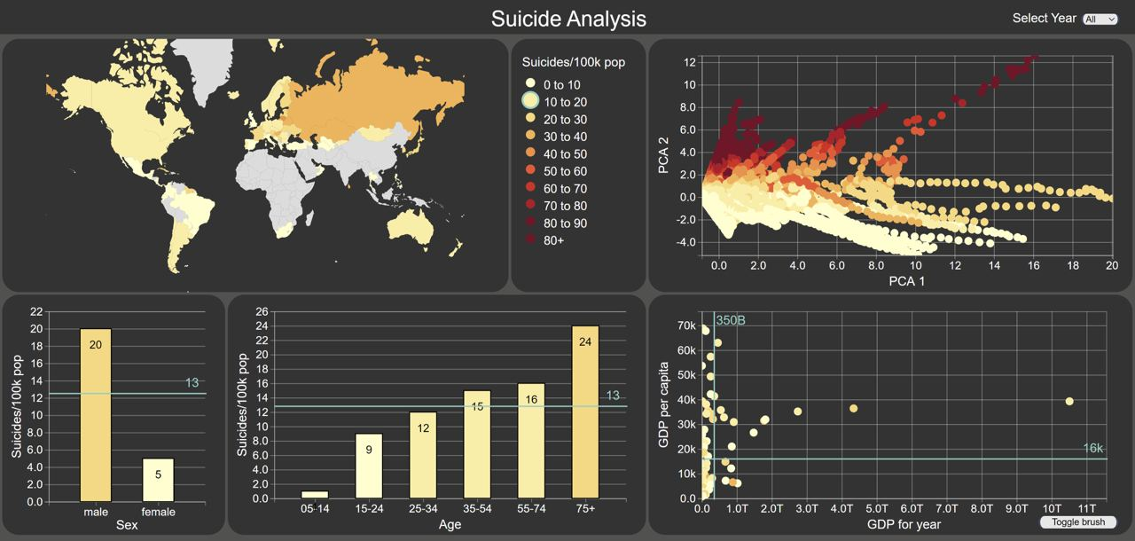
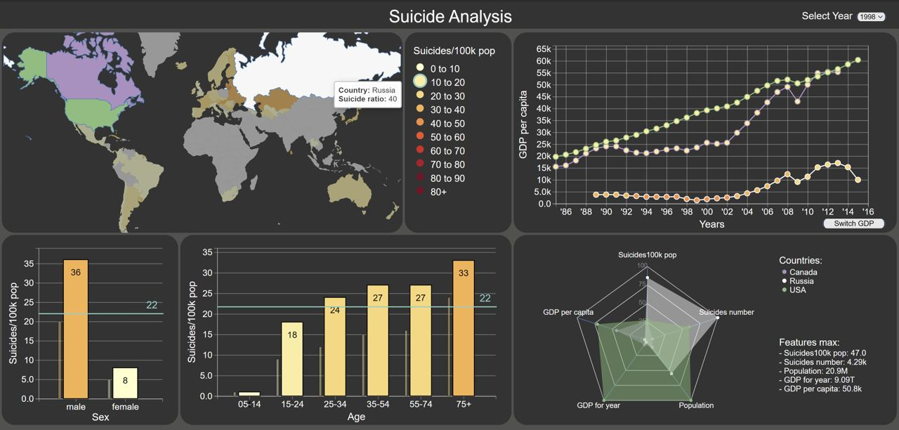
Visualizations
Two main views:
Focused on world countries
Focused only on selected countries

Slide 11
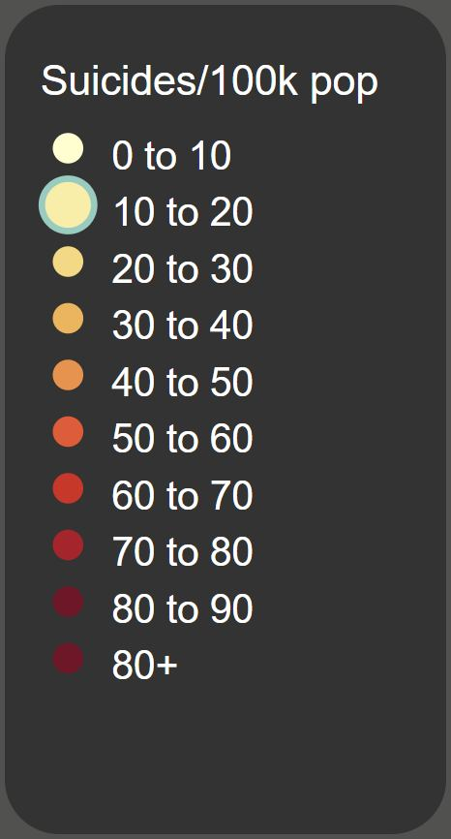
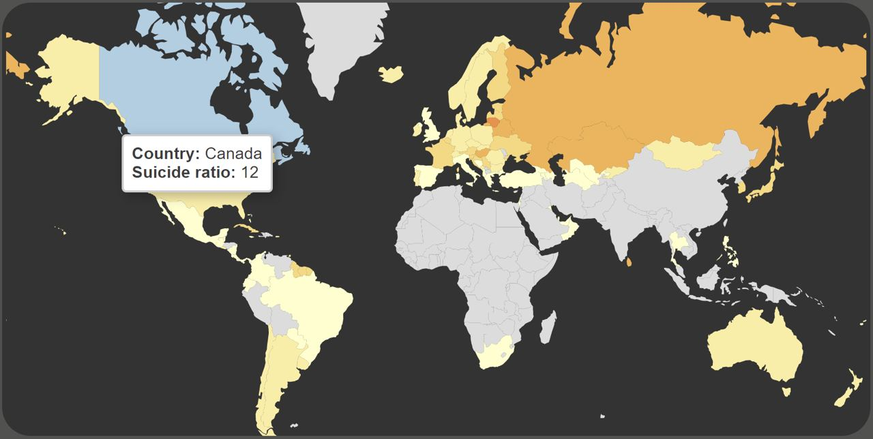
Choropleth Map
It is a simple view that allows to visualize in an effective way how suicides rates varies across the world.
Every country is colored according to its suicides rate and the intervals present in the interactive legend.
Colors of the countries changes according to the selected filters due to the interactions with other visualizations.

Slide 12
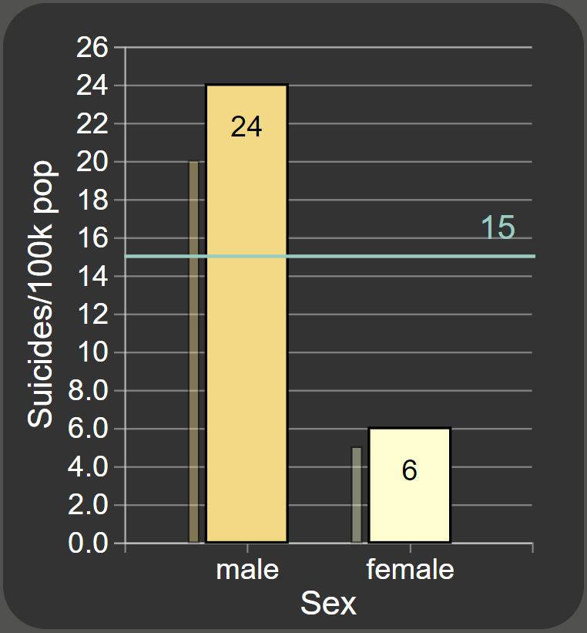
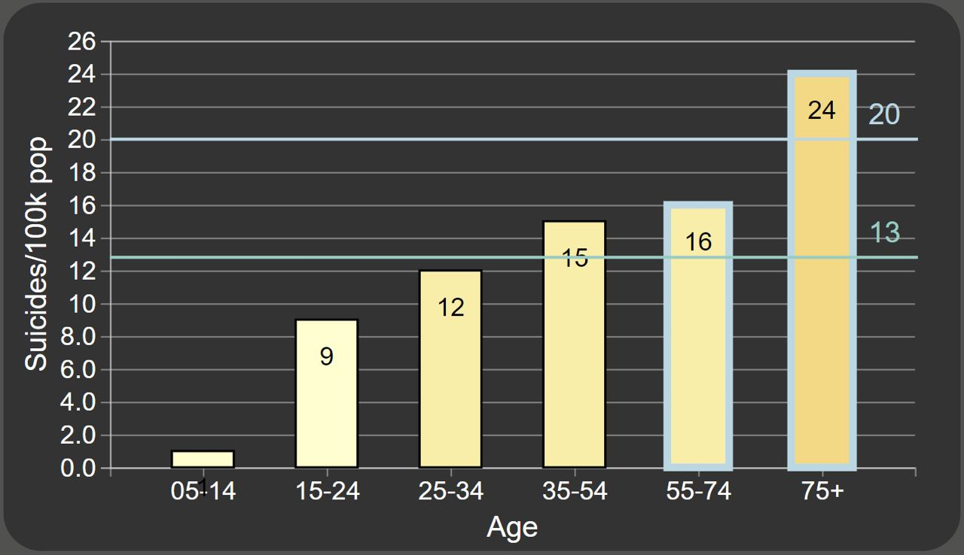
Sex & Age Bar Charts
Sex Bar Chart represents the biological sex on the categorical axis and the suicide ratio on the other axis.
Age Bar Chart represents the age group on the categorical axis and the suicide ratio on the other axis.
A narrow vertical line represents the values before applying the filters, while a light green horizontal line represents the mean of the values.
The Age chart also has a second light blue line representing the mean values for the selected bars only.
Colors are encoded following the same schema that is used for the Choropleth Map.

Slide 13
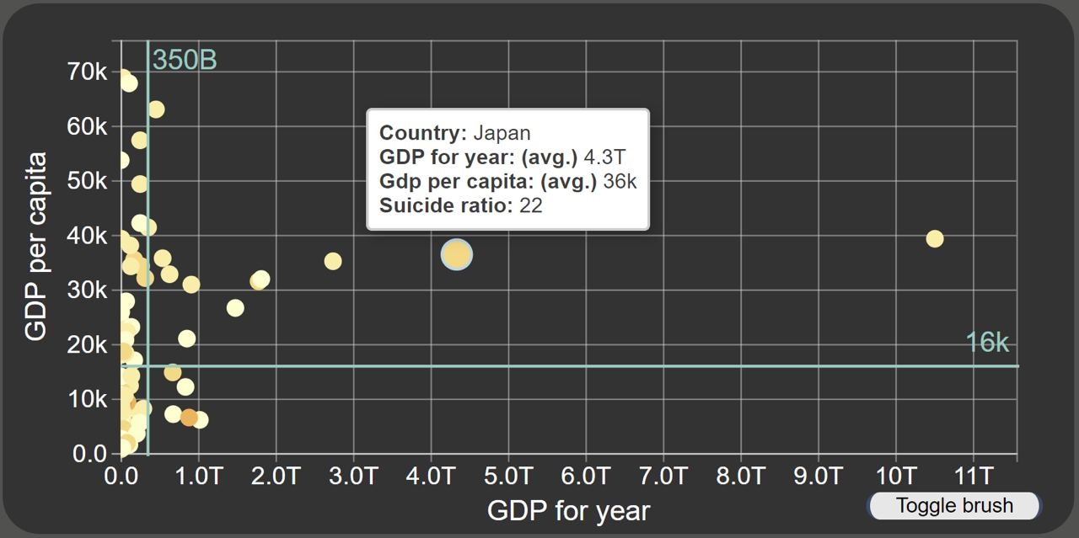
Scatterplot
The data are displayed as a collection of points.
“GDP for year” determines the value on the horizontal axis, while “GDP per capita” determines the value on the vertical axis.
The color of each point is associated to the respective suicides rate, following the encoding of the Choropleth Map.
In order to add more information, the mean are displayed, and interactions are allowed within the chart and with the other visualizations.

Slide 14
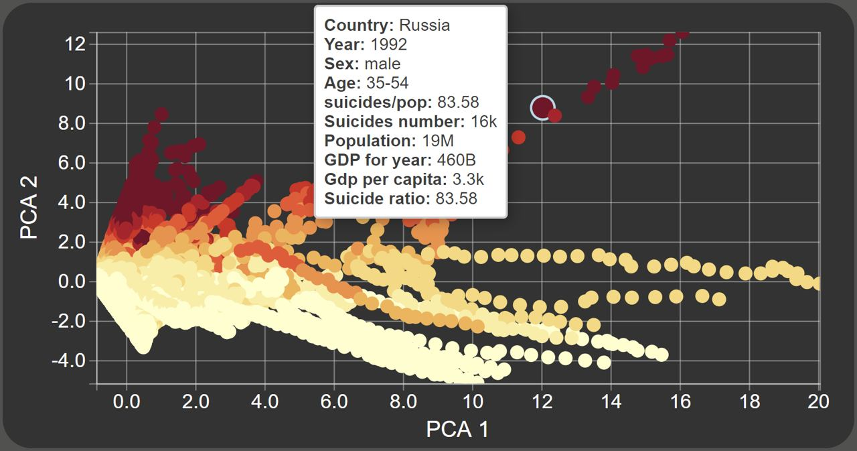
PCA Chart
Another scatterplot that displays each element of the dataset according to the first two PCA components.
This visualization helps to point out outliers and clusters. Both between starting data and filtered ones.
The color of the points is given by their suicide rates, also in this case the colors schema follows the one used in the Choropleth Map.

Slide 15
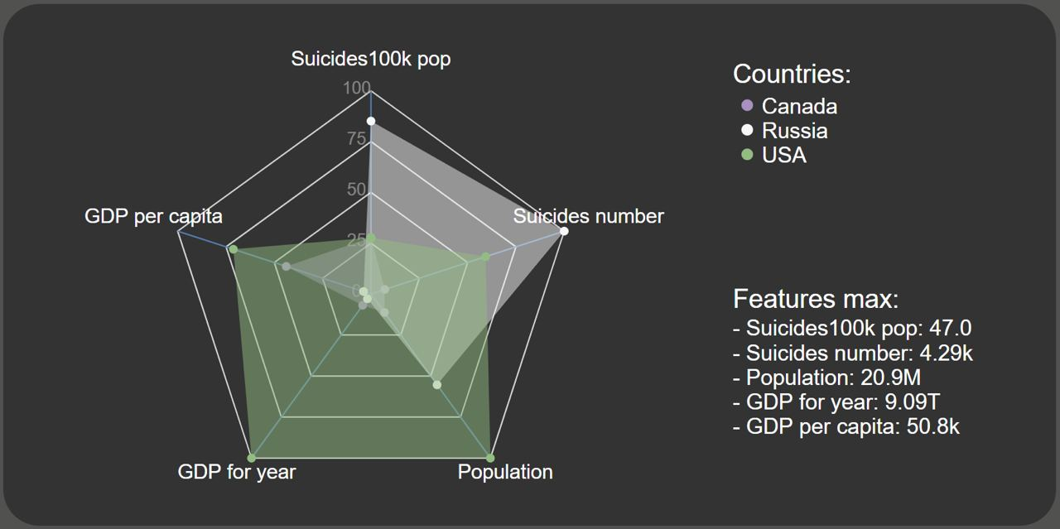
Radar Chart
Radar chart is used to display multivariate data in the form of a two-dimensional chart: population, gdp per capita, gdp for year, #suicides and suicides rates.
We used the radar chart to represent all data of the selected countries in a unique graph and compare the features between different countries.
On the right, there is a legend which represents the colors of the selected countries and the maximum value for each feature.

Slide 16
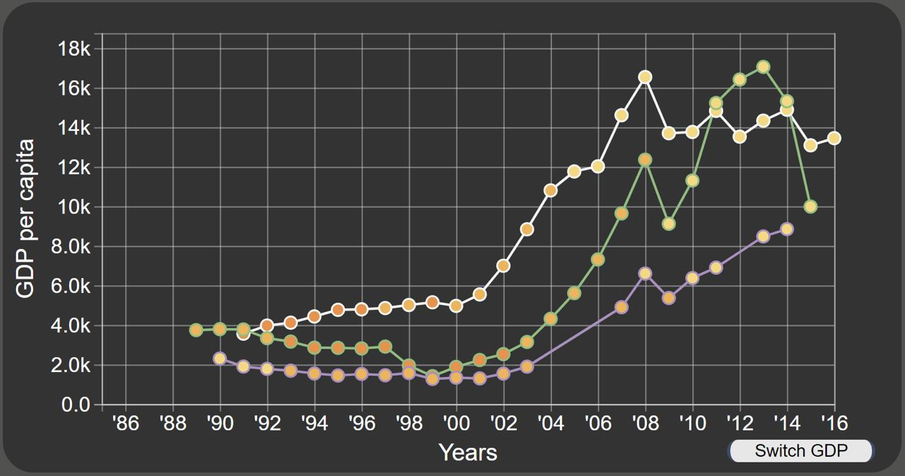
Line Chart
This visualization is used to understand whether or not there is a link between GDP and suicide rate over the years.
The years are represented on the horizontal axis , while GDP values (we can select between GDP per capita and GDP for year by clicking on the button) are represented on the vertical axis.
The color of the markers follows the suicide rate encoding of the Choropleth Map, while the color of path and stroke is relative to the radar encoding for the countries.

Slide 17
Conclusion and Future work

Slide 18
Conclusion
Our visual analytics system wants to support all those people who are analyzing this issue and want to understand how to mitigate this illness.
The simple interface provides the user with a complete interactive visual analytics environment, in which they can filter the data as needed and perform different complex analyses.
As expected, our results are similar to those we found in the literature
Suicides rates among the countries differ widely.
Male rates are significantly higher than female rates, as well, increasing the age, the suicide rates considerably rises.
The general country income may have a significant impact on this illness. However, we must consider that the reasons behind this correlation are much more complex than what we can summarize in this “superficial” analysis.
Some low- and middle-income countries have significantly lower suicide rates than high-income countries, even if, in general, high-income countries tend to have low suicide rates. Some factors that could explain the presence of this issue are mental health, humanitarian crises and other forms of adversity that affect people over the world.

Slide 19
Future Work
We might include these elements to extend our system and provide a more exhaustive analysis:
The incidence of mental health conditions inside the population and the policies adopted by the countries to heal these conditions. In fact, clinical studies definitively establish that psychiatric disorders are a major contributing factor to suicide;
A deeper analysis of living conditions inside the different countries;
A comparison between suicides and other causes of death.

Slide 20

You can find the repo at:
https://github.com/BCI-ECS-sapienza/Suicide-rate-visualization

